Slide 1
Cyclistic ride-sharing analysis
Differentiating casual riders from annual members to inform the upcoming marketing campaign.
Karl Madl, updated for June 2022

Slide 2
Objective
Cyclistic is a fictitious alias for a bicycle ridesharing company in Chicago. The goal of this mock is to help inform the marketing team, whose campaign is aimed towards converting “casual riders” into annual members. Towards this aim, I identify key differences between the groups and general patterns in casual riding to provide opportunities for effective marketing.

Slide 3
Data
The data used was provided in csv files by month. We only consider the last 12 months in our analysis. Because the analysis is to focus on Cyclistic riders only we have the population data and need not use statistical methods to make inferences about the data.

Slide 4
Data
The 12 separate csv files were loaded into dataframes and subsequently concatenated together for a master dataframe with ~5.75 million rows and 13 columns:
Ride ID
Rideable type: “classic”, “electric”, or “docked”
Datetimes of when ride started and ended (2 separate columns)
Station names and IDs for starting station and ending station (4 cols)
Latitude and longitude coordinates for each starting and ending station (4 cols)
Membership status: “member” or “casual”

Slide 5
Data Cleaning
140 rides had the start time later than the end time, resulting in negative time spent on the bike.
Solution: I swapped the start and end times for these rides. Due to the small relative amount and impossibility of accuracy, I could’ve dropped these observations instead but chose to potentially save as much data as possible.
790,000 observations were missing starting station names while 843,000 observations were missing ending station names, with a good deal of overlap. 4,766 observations were missing ending latitude and longitude coordinates, all these observations overlapped with those missing ending station names.
Solution: There’s no way to know where the 4,766 rides ended so those observations were dropped. For the rest of the missing data, a dictionary was created matching station names with known latitude and longitude coordinates and then using this dictionary to determine the missing station names based on their coordinates.
Some bias may be introduced as all the 4,766 dropped rides used electric bikes

Slide 6
analysis
There are four key differences and/or patterns that were identified:
What
When
How Long
Where

Slide 7
whAT
Cyclistic offers 3 rideables:
Classic bike
Electric bike
Docked bike
How are member and casual rides distributed over these?

Slide 8
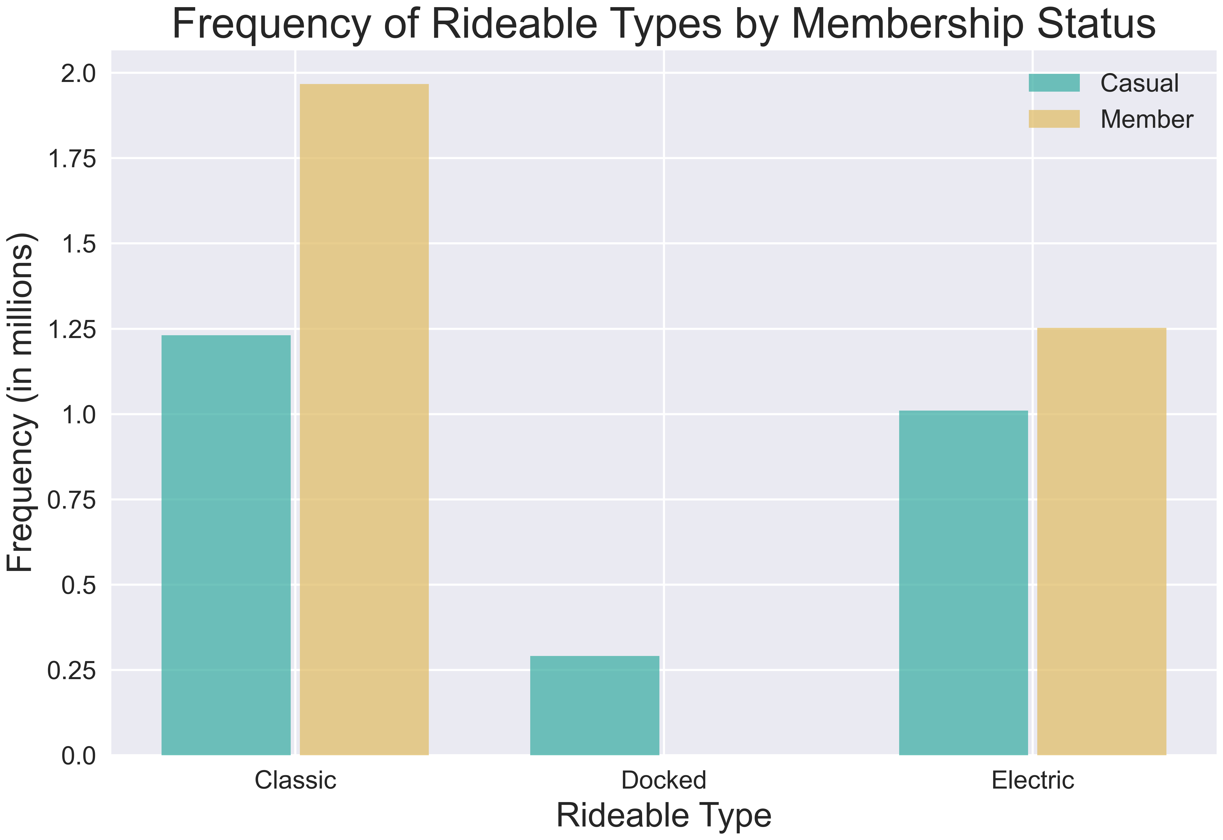
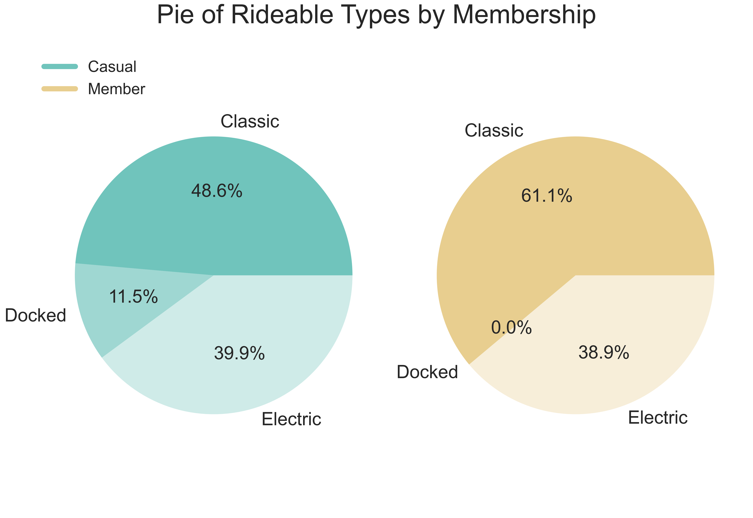
What
While members and casuals ride electric at the same rate, only one member ride was on a docked bike this past year. The difference is made up in classic bike rides.

Slide 9
analysis
There are four key differences and/or patterns that were identified:
What
When
How Long
Where

Slide 10
When
When do casual riders and members ride bikes?
There are 3 levels of “when”:
Yearly scale over months
Weekly scale over days
Daily scale over hours/minutes

Slide 11
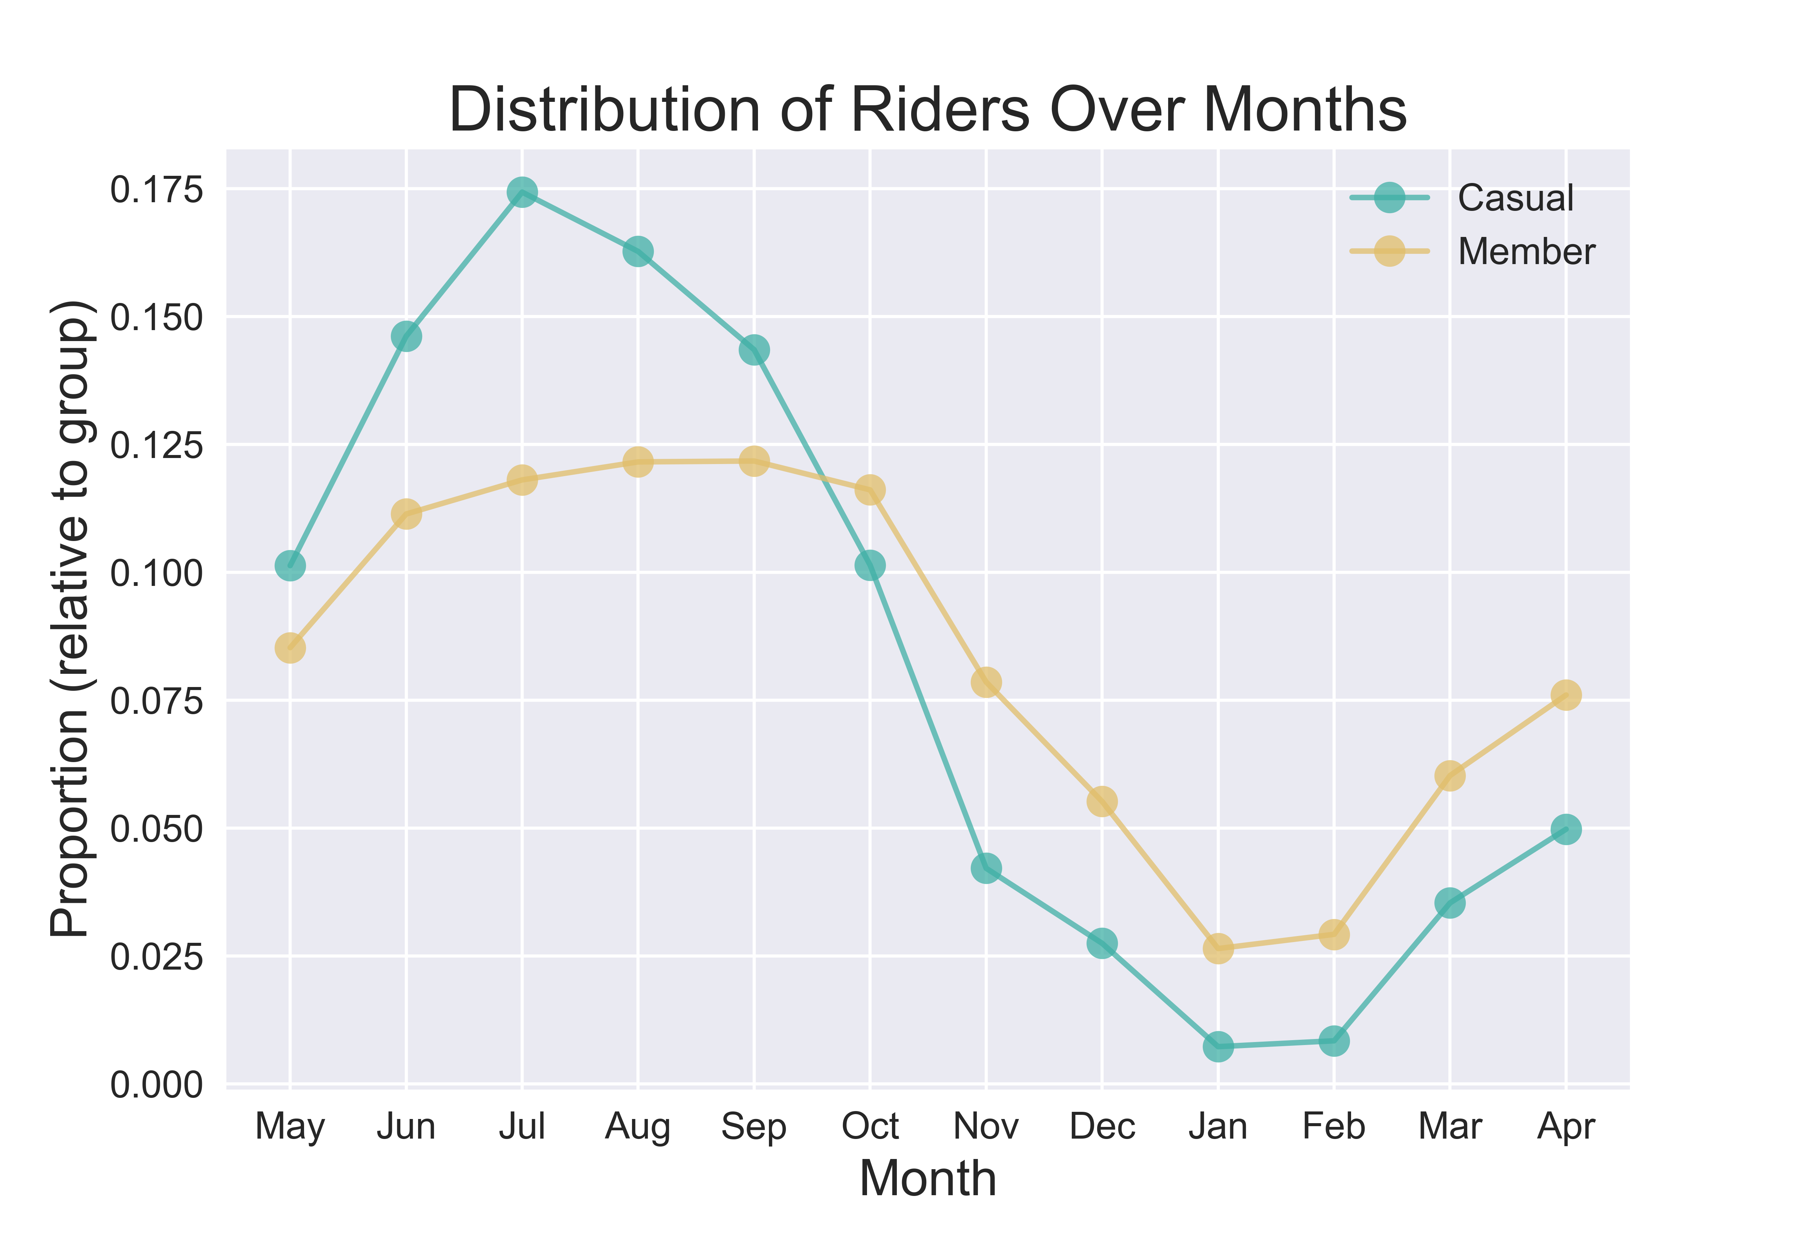
When
There are 3 levels of “when”:
Yearly scale over months
Weekly scale over days
Daily scale over hours/minutes

Slide 12
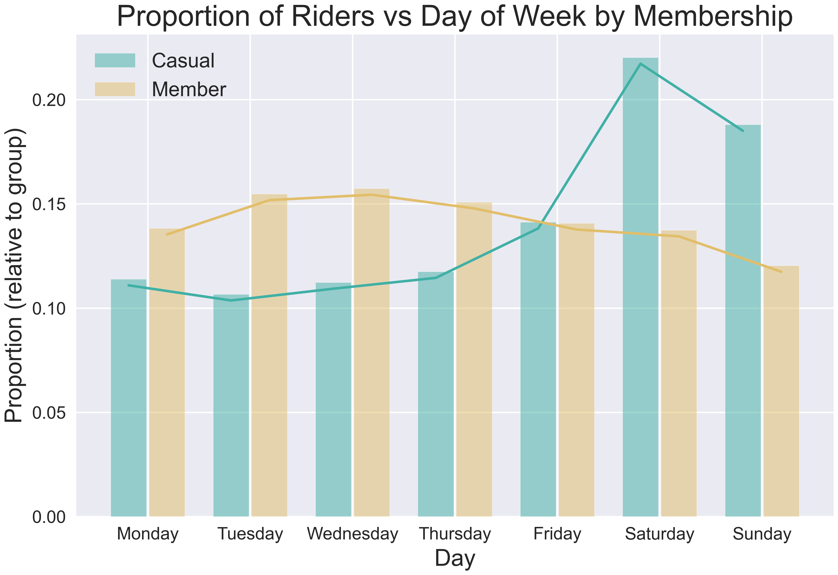
When
There are 3 levels of “when”:
Yearly scale over months
Weekly scale over days
Daily scale over hours/minutes

Slide 13
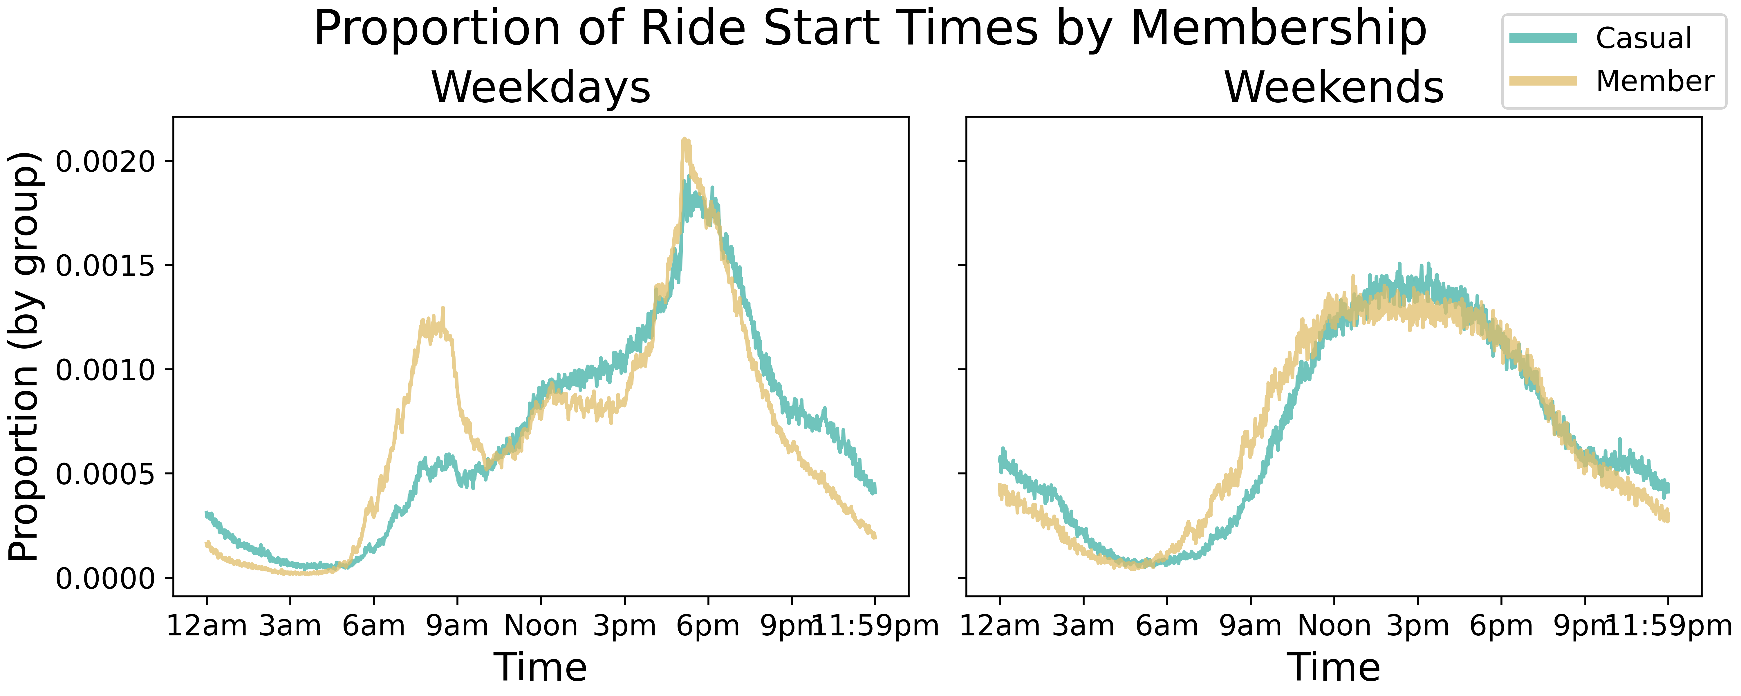
When
There are 3 levels of “when”:
Yearly scale over months
Weekly scale over days
Daily scale over hours/minutes

Slide 14
analysis
There are four key differences and/or patterns that were identified:
What
When
How Long
Where

Slide 15
How long
The ride_length column was created by taking the difference between start and end times, kept in minutes.
There are some large outliers in the data here (e.g., times well over 30 days) so 1% trimmed statistics were used
The ride_length data was analyzed against multiple categorical variables

Slide 16
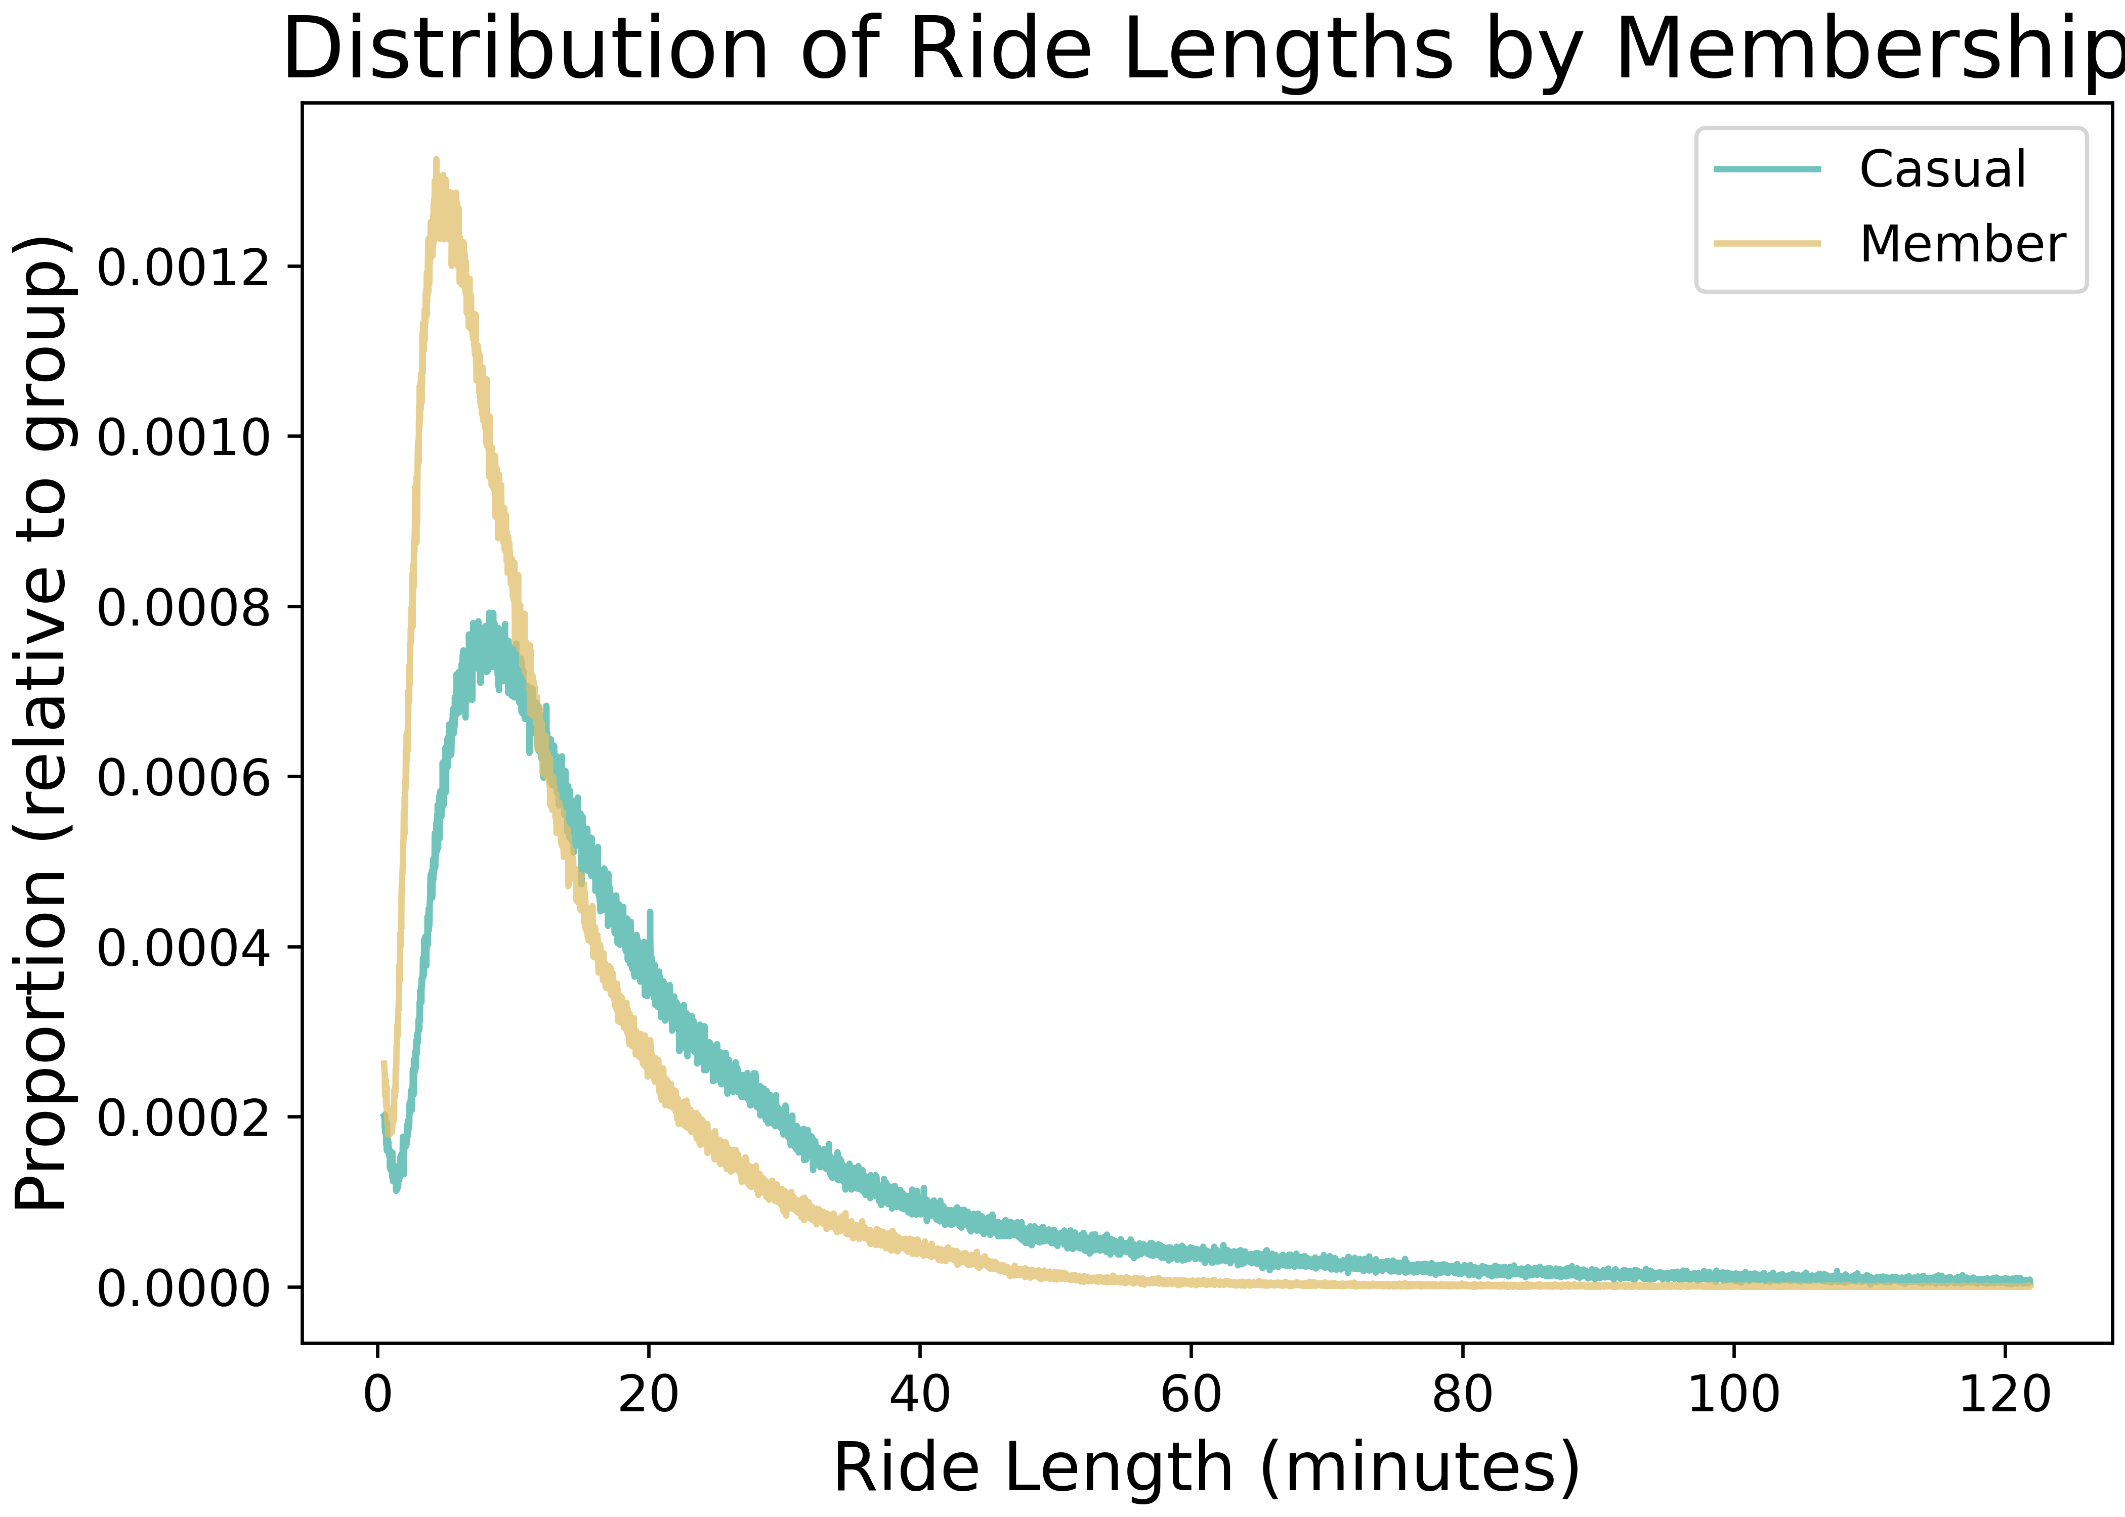
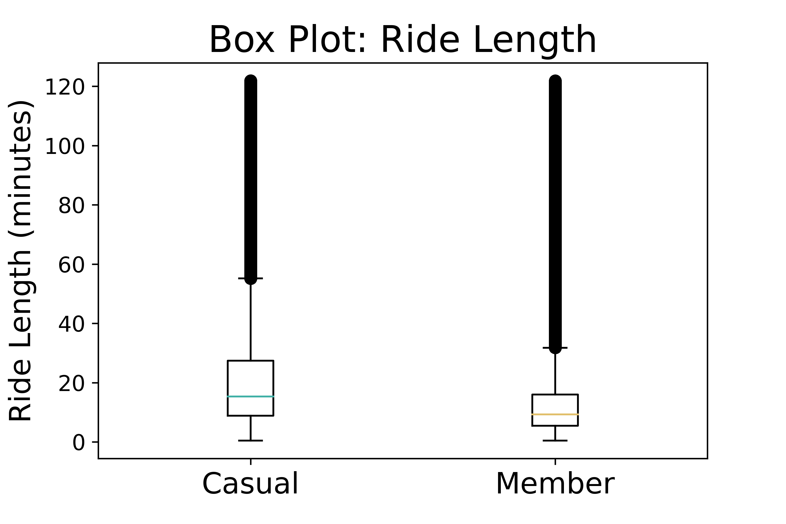
How long
Ride time lengths distribution is more positively skewed for casual riders than members
Average ride time length for
Casual riders is 23 minutes
Members is 12 minutes

Slide 17
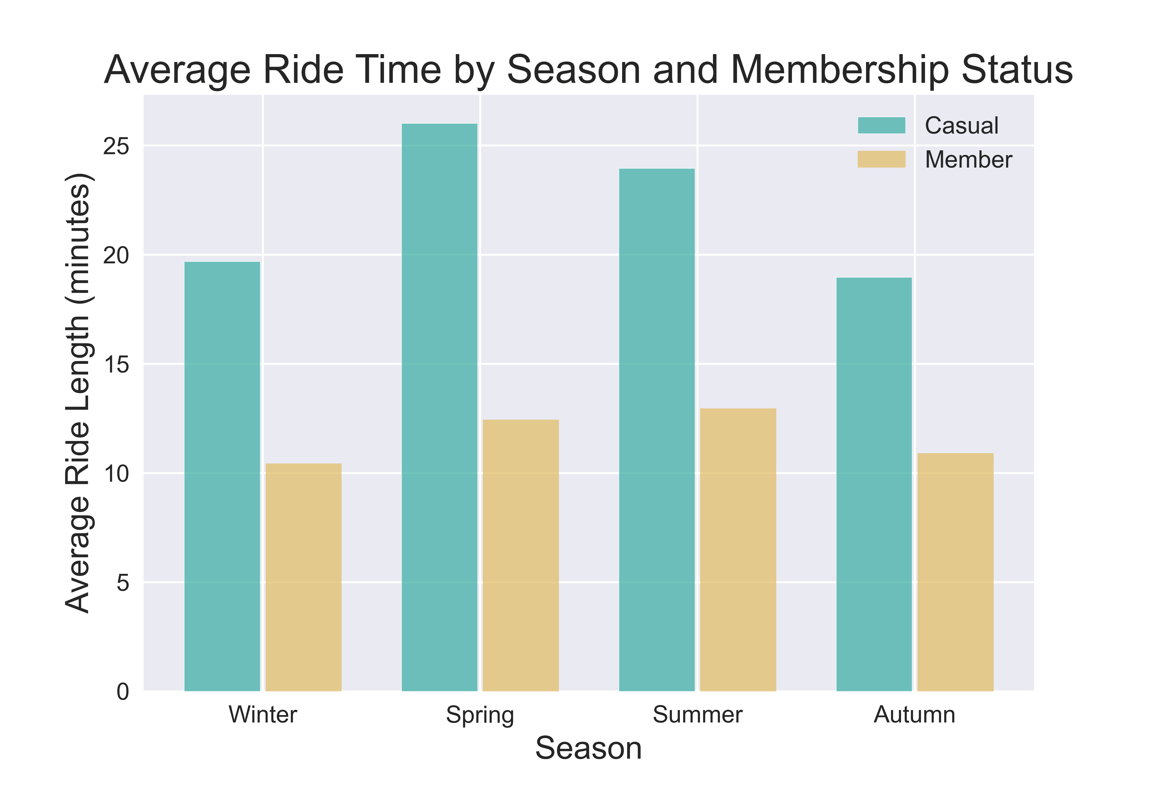
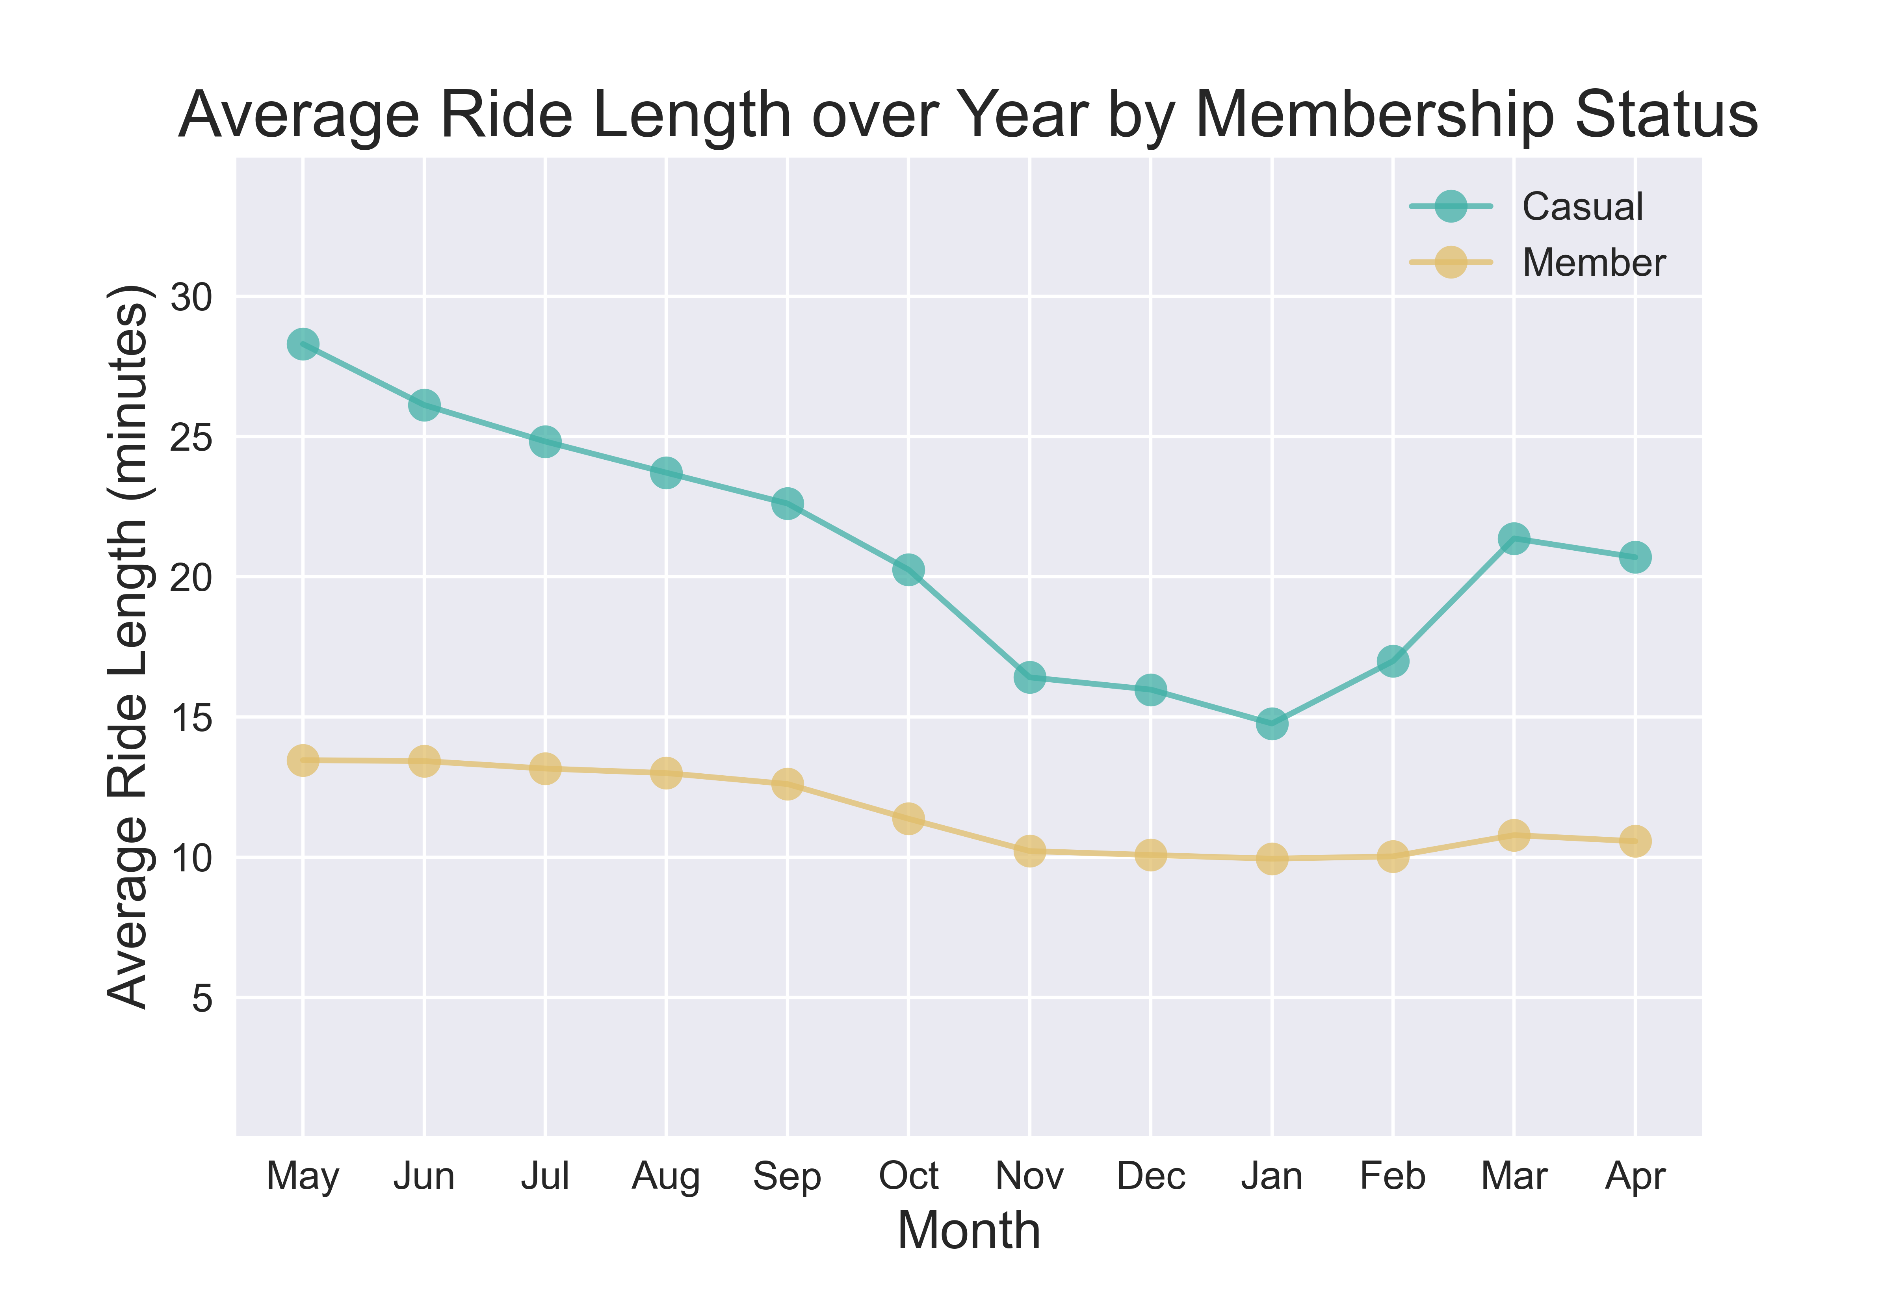
How long
The greatest differences in ride times occur in the spring summer months.
Members are consistent throughout the year while casual riders show much more variance.

Slide 18
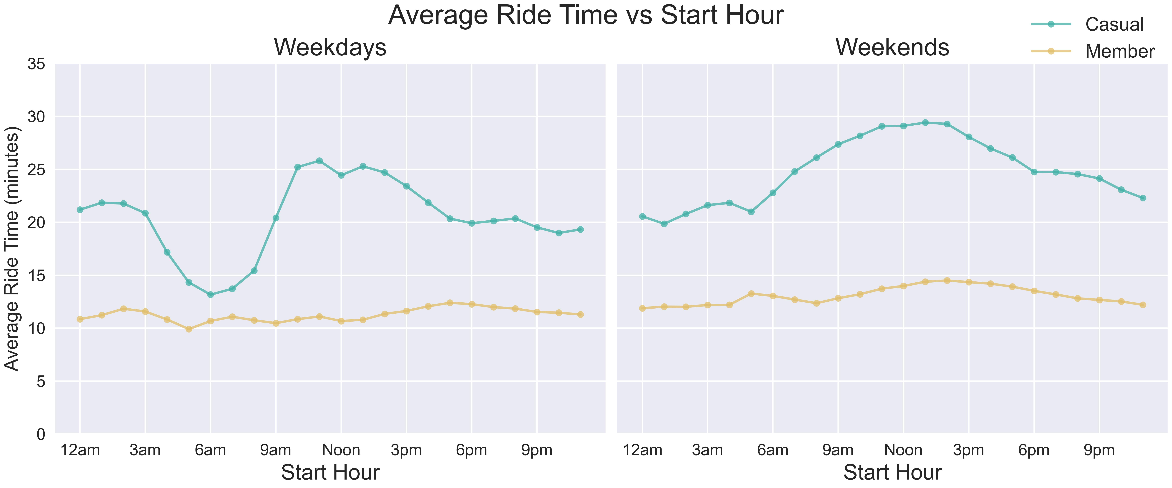
How long
Casual riders have the shortest trips weekday mornings and the longest around noon on weekends.
Members ride slightly longer on weekends and are consistent across all times of day

Slide 19
analysis
There are four key differences and/or patterns that were identified:
What
When
How Long
Where

Slide 20
where
What areas were riders in most often?
We analyzed which stations casual riders and members interacted with most frequently to inform possible physical marketing locations.
We used machine learning to separate stations into 3 areas:
University of Chicago
Navy Pier
North Side

Slide 21
where
To analyze the spread of station interactions, we create a distribution of the Euclidean Norms from the average location of all interactions to each station interaction. We choose standard deviation as a measure of spread.
The distribution for members has a standard deviation almost 4x as large as the standard deviation for casual riders. Using different norms leads to various differences between the standard deviations.
In every case, the standard deviation of the members distribution is greater than that of the casuals → Casual Riders are more condensed around the center of the distribution (near Navy Pier)

Slide 22
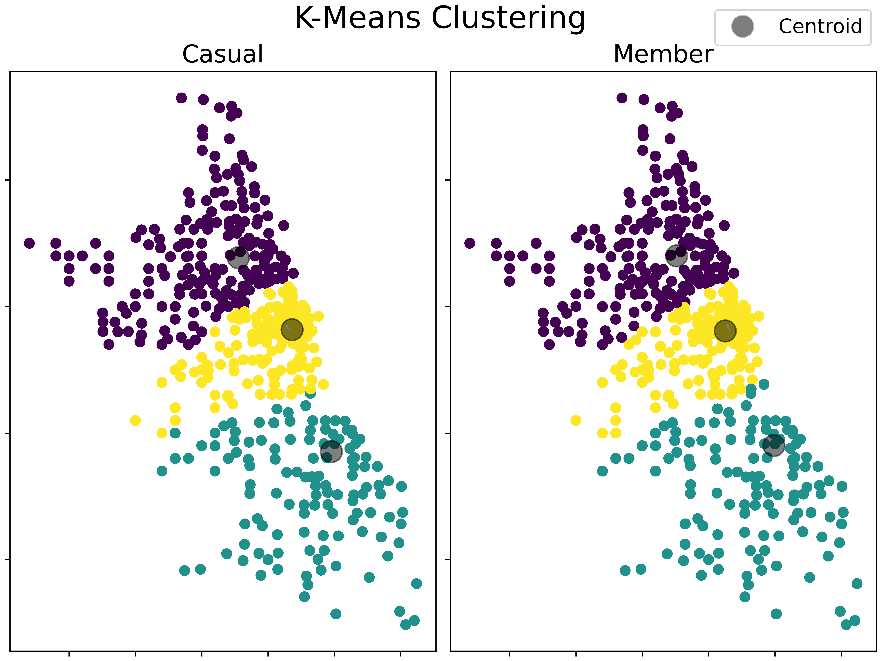
Where
Elbow method with the sum of squares was used to determine the optimal number of clusters
3 for casual riders and members
K-Means clustering algorithm grouped the stations similarly, but not identically.
Member cluster sizes are more equivalent in size, matching the expected behavior from being more spread out

Slide 23
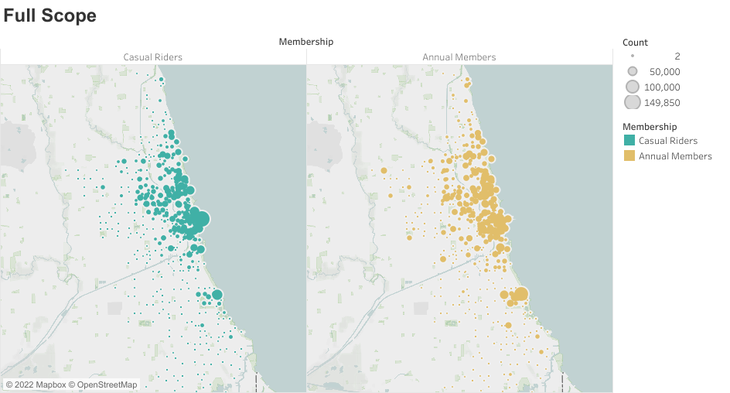
Where

Slide 24
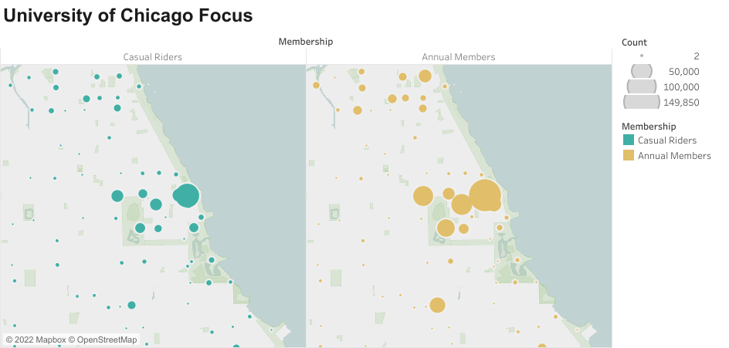
Where

Slide 25
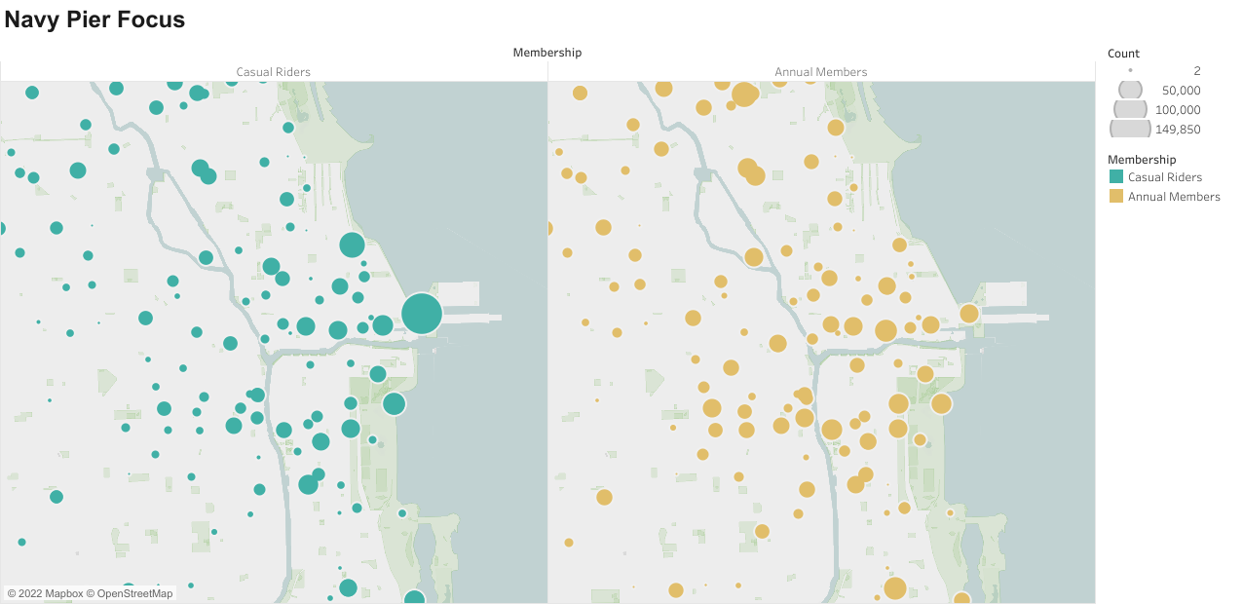
Where

Slide 26
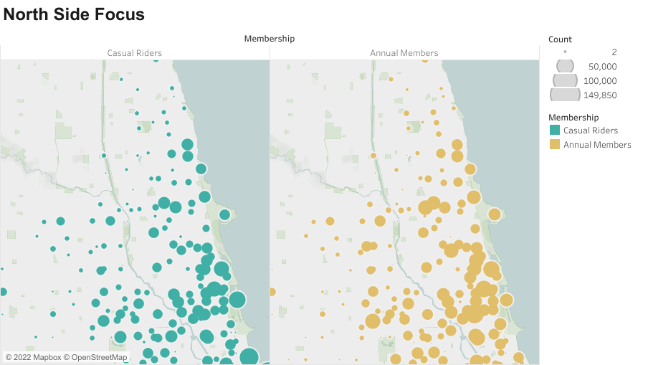
Where

Slide 27
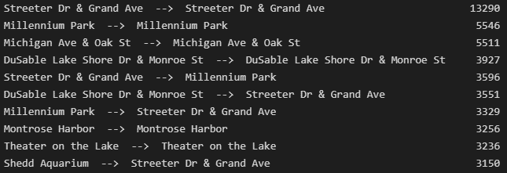
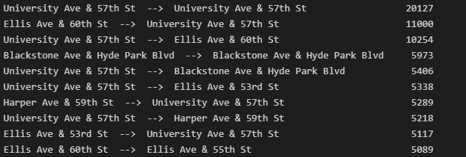
Where
“Routes” were created as origin-destination pairs (we do not have access to during-ride location tracking, so these aren’t really routes)
10.6% of all casual riders began and ended their ride at the same station; 5.9% of all members did the same.
The top 10 most popular “routes” are given on the right.
Most of the casual rides top 10 are in the Navy Pier and lower North Side regions
Most of the member rides top 10 are in the University of Chicago region
CASUALS
MEMBERS

Slide 28
Final conclusions
Summary of findings and general recommendations for marketing strategy based on the data.

Slide 29
Targeting docked bikes would yield a high rate of reaching the targeted audience of the campaign (casual riders)
Late spring through the summer are when casual riders are most active. Marketing during these months, and in the early spring to incentivize ridership, is recommended to reach as many riders as possible.
Casual riders spend twice as much time per ride as members; providing information to the potential savings a member may see is an option.
Focusing physical advertising space in areas of high station interactions for casual members is advised; namely, the most popular stations are Streeter Dr & Grand Ave, Millennium Park, and Michigan Ave & Oak St. A full list of stations and their interaction counts is available in the full report.

Slide 30
The general patterns of members indicate that they use Cyclistic bikes to make their daily commute and embark on some leisure activities.
Casual riders seem to be predominantly made up of leisure riders – tourists or locals choosing a different way to get around on a given day, particularly in the warmer months and off days.
For these casual riders, an annual membership may not make sense. I propose the possibility of a temporary membership/pass to draw in more casual riders to the membership program. These passes can be seasonal, monthly, weekly, or for just a weekend.
Lastly, although Cyclistic does well at gaining members at/near the University of Chicago, there is room for growth both there and at Loyola University. Continuing marketing to students, faculty, and staff of local colleges is another potential avenue at attracting more members.

